Slide 1
Docker - Docker File and Image Management - Docker Volume
Krishnappa, Nandisha

Slide 2

Docker
Dockerfile and Image Management
Docker Volumes

Slide 3
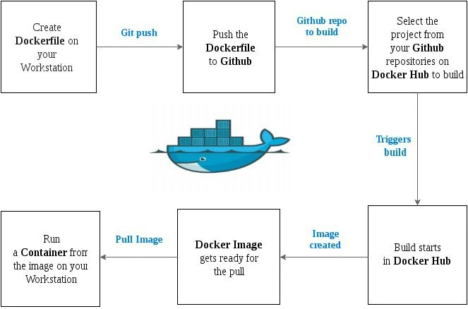
Docker Lifecycle

Slide 4
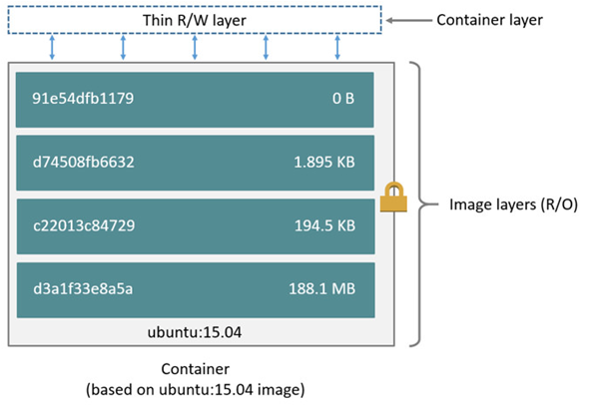
Image and Container

Slide 5
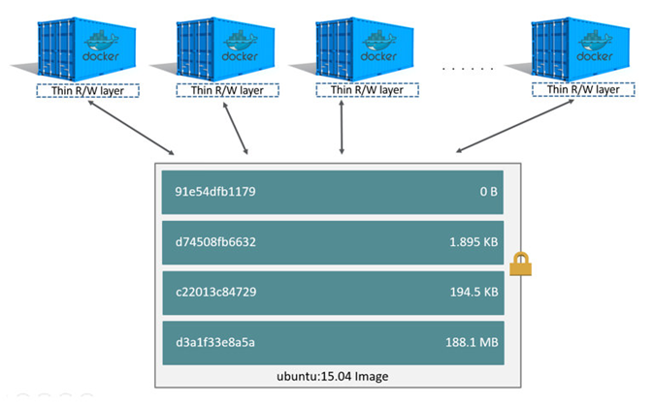
Multiple Containers using same image

Slide 6
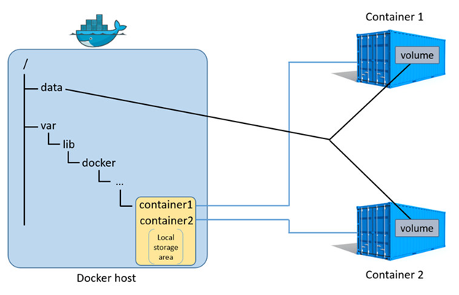
Sharing Storage Space

Slide 7
Docker Commands
docker create | Creates a container but does not start it
docker rename | Allows the container to be renamed
docker run | Creates and starts a container in one operation
docker run –rm | Removes container when stopped
docker run --log-driver=syslog | Runs Docker with custom log driver
docker ps | Shows running containers
docker logs | Gets logs from container
docker inspect | Looks at all the info on a container
docker events | Gets events from container
docker port | Shows public facing port of container
docker top | Shows running processes in container
docker stats | Shows containers’ resource usage statistics

Slide 8
Image Management
docker images | Shows all images
docker import | Creates an image from a tarball
docker build | Creates image from Dockerfile
docker commit | Creates image from a container, pausing it temporarily if it is running
docker rmi | Removes an image

Slide 9
Docker File
FROM python:2.7
COPY . /app
WORKDIR /app
CMD python app.py
FROM, base image - creating a layer from the python:2.7 image.
COPY, adds some files from your Docker client’s current directory.
WORKDIR, changes directory inside the container.
CMD, specifies what command to run within the container.

Slide 10
Sections/Directives in a Docker file
EXPOSE | Informs Docker that the container listens on the specified network ports at runtime; does not make ports accessible
ENV | Sets environment variables
ADD | Copies new files, directories or remote file to container; invalidates caches; avoid ADD and use COPY instead
COPY | Copies new files or directories to container

Slide 11
Sections/Directives in a Docker file
ENTRYPOINT | Configures a container that will run as an executable
VOLUME | Creates a mount point for externally-mounted volumes or other containers
USER | Sets the username for following RUN/CMD/ENTRYPOINT commands
WORKDIR | Sets the working directory

Slide 12
Sections/Directives in a Docker file
ARG | Defines a build-time variable
ONBUILD | Adds a trigger instruction when the image is used as the base for another build
STOPSIGNAL | Sets the system call signal that will be sent to the container to exit
LABEL | Apply key/value metadata to your images, containers, or daemons

Slide 13
RUN
The RUN instruction will execute any commands in a new layer on top of the current image and commit the results. The resulting committed image will be used for the next step in the Dockerfile.
Two forms:
RUN <command> (shell form, the command is run in a /bin/sh -c on Linux)
RUN ["executable", "param1", "param2"] (exec form)
Environment variables can be replaced during docker run:
docker run --env <key>=<value>

Slide 14
ENTRYPOINT
ENTRYPOINT has two forms:
ENTRYPOINT ["executable", "param1", "param2"] (exec form, preferred)
ENTRYPOINT command param1 param2 (shell form)
Command line arguments to docker run <image> will be appended after all elements in an exec form ENTRYPOINT, and will override all elements specified using CMD.

Slide 15
CMD and ENTRYPOINT
Both CMD and ENTRYPOINT instructions define what command gets executed when running a container.
Dockerfile should specify at least one of CMD or ENTRYPOINT commands.
ENTRYPOINT should be defined when using the container as an executable.
CMD should be used as a way of defining default arguments for an ENTRYPOINT command or for executing an ad-hoc command in a container.
CMD will be overridden when running the container with alternative arguments.

Slide 16
EXPOSE
The EXPOSE instruction informs Docker that the container listens on the specified network ports at runtime.
EXPOSE 80/tcp
EXPOSE 80/udp
docker run -p 80:80/tcp -p 80:80/udp ...

Slide 17
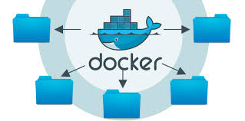
Docker Storage

Slide 18
Why Volumes ?
By default all files created inside a container are stored on a writable container layer.
The data doesn’t persist when that container is no longer running, and it can be difficult to get the data out of the container if another process needs it.
A container’s writable layer is tightly coupled to the host machine where the container is running. You can’t easily move the data somewhere else.
Writing into a container’s writable layer requires a storage driver to manage the filesystem.

Slide 19
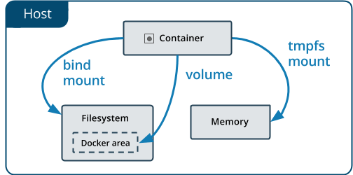
Choose the right type of mount

Slide 20
Volumes?
Volumes are stored in a part of the host filesystem which is managed by Docker(/var/lib/docker/volumes/ on Linux).
Non-Docker processes should not modify this part of the filesystem.
Volumes are the best way to persist data in Docker.

Slide 21
Bind?
Bind mounts may be stored anywhere on the host system.
They may even be important system files or directories.
Non-Docker processes on the Docker host or a Docker container can modify them at any time.

Slide 22
Volume Commands
Create a volume : $ docker volume create my-vol
List volumes : $ docker volume ls
Inspect a volume : $ docker volume inspect my-vol
Remove a volume : $ docker volume rm my-vol
$ docker run -d --name devtest --mount source=myvol2,target=/app nginx:latest
$ docker run -d --name devtest -v myvol2:/app nginx:latest

Slide 23
Q & A

Slide 24
What Next?
Docker Services
Docker Swarm
Kubernetes☺

